Slide 1

Topics to be covered
Definition of Computer
Application of Computer
Peripheral devices
Architecture of Computer
Basic Components of Computer
Types of Data Storage

Slide 2
Computer
A computer is a machine that can be instructed to carryout sequences of arithmetic or logical
operations automatically via computer programming.
OR
A computer is a machine or device that performs processes, calculations and operations based on instructions provided by a software or hardware program.
It has the ability to accept data (input), process it, and then produce outputs.

Slide 3
Applications of Computer
Home
online bill payment
watching movies or shows at home
home tutoring
social media access
playing games
internet access, etc.
Industry
managing inventory
designing purpose
interior designing
video conferencing
Online marketing

Slide 4
Medical Field
database of patients’ history
Diagnosis
X-rays
live monitoring of patients
Surgeons nowadays use robotic surgical devices
Entertainment
playing games
listening to music
MIDI instruments greatly help people in the entertainment industry in recording music with artificial instruments
Note: MIDI is an acronym that stands for Musical Instrument Digital Interface. It’s a way to connect devices that make and control sound — such as synthesizers, samplers, and computers — so that they can communicate with each other, using MIDI messages.
Photo editors

Slide 5
Education
online classes
online examinations
referring e-books
online tutoring
Government
computers are used in data processing, maintaining a database of citizens
missile development
Satellites
rocket launches

Slide 6
Banking
computers are used to store details of customers
conduct transactions-withdrawal and deposit of money through ATMs
Business
transaction processing
Investments
Sales
Expenses
markets

Slide 7
Training
Many organizations use computer-based training to train their employees, to save money and improve performance
Ex-Video conferencing
Science and Engineering
Supercomputers have numerous applications in area of Research and Development (R&D).
Scientists use computers to plot and analyze data to have a better understanding of earthquakes.

Slide 8
Input device
Keyboard
Mouse
Trackball (computer cursor control device like mouse, the trackball is an upside-down mouse that rotates in place within a socket.)
Output Device
Monitor
Printer
Speaker

Slide 9
Both Input–Output Devices:
Modems (it sends data (upload/output) and receives data (download/input)
Network cards (The purpose of the network card is to establish a path of communication between the user and the computer. This path works for both sending the data and collecting back the data from the computer)
Touch Screen
Headsets (Headset consists of Speakers and Microphone.)

Slide 10
Architecture of computer:
Computer system has five basic units that help the computer to perform operations, which are given below:
Input Unit
Output Unit
Storage Unit
Arithmetic Logic Unit
Control Unit

Slide 11
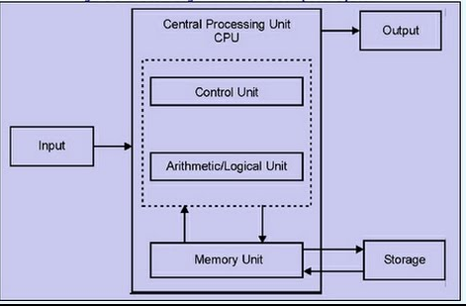

Slide 12
Input Unit
The source program/high level language program/coded information/simply data is fed to a computer through input devices keyboard is a most common type.
Input unit performs following tasks:
Accept the data and instructions from the outside environment.
Convert it into machine language.
Supply the converted data to computer system.
Example
Joysticks, trackballs, mouse, scanners etc are other input devices

Slide 13
Output Unit
These actually are the counterparts of input unit.
Its basic function is to send the processed results to the outside world.
Examples:-
Printer, speakers, monitor etc.

Slide 14
Storage Unit
This unit holds the data and instructions. It also stores the intermediate results before these are sent to the output devices. It also stores the data for later use.
The storage unit of a computer system can be divided into two categories:
1. Primary Storage
2.Secondary Storage

Slide 15
Primary Storage:
This memory is used to store the data which is being currently executed. It is used for temporary storage of data.
The data is lost, when the computer is switched off.
RAM is used as primary storage memory.

Slide 16
Secondary Storage:
The secondary memory is slower and cheaper than primary memory.
It is used for permanent storage of data.
Examples: -
Magnetic disks & tapes, optical disks (ie CD-ROM’s), floppies etc.,

Slide 17
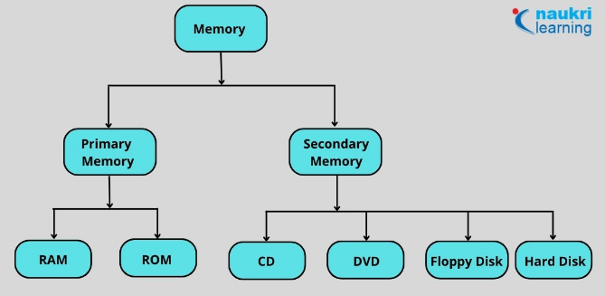

Slide 18
Comparison Parameters | Primary Memory | Secondary Memory
Storage validity | Primary memory is the main memory and stores data temporarily. | Secondary memory is the external memory and stores data permanently.
Access | The CPU can directly access the data. | The CPU cannot directly access the data.
Volatility | Primary memory is volatile. It loses data in case of a power outage. | Secondary memory is non-volatile, and data is stored even during a power failure.
Storage | Data is stored inside costly semiconductor chips. | Data is stored on external hardware devices like hard drives, floppy disks, etc.
Division | It can be divided into RAM and ROM | They do not have such a classification. Secondary memories are permanent storage devices like CDs, DVDs, etc.
Speed | Faster | Slower
Stored data | It saves the data that the computer is currently using. | It can save various types of data in various formats and huge sizes.

Slide 19
Arithmetic Logical Unit
All the calculations are performed in ALU of the computer system.
The ALU can perform basic operations such as addition, subtraction, division, multiplication etc.
Whenever calculations are required, the control unit transfers the data from storage unit to ALU. When the operations are done, the result is transferred back to the storage unit.

Slide 20
Control Unit
It controls all other units of the computer. It controls the flow of data and instructions to and from the storage unit to ALU.
Thus it is also known as central nervous system of the computer.
The main function of a control unit is to fetch the data from the main memory, determine the devices and the operations involved with it, and produce control signals to execute the operations.

Slide 21
CPU(Central Processing Unit)
The control unit and ALU are together known as CPU.
CPU is the brain of computer system.
It performs following tasks:
It performs all operations.
It takes all decisions.
It controls all the units of computer.

Slide 22
Peripherel devices:
Peripheral devices are devices that are attached to a computer system.
Input devices, output devices, and the various storage units are all peripheral devices. These devices increase the basic services provided by the computer system.
Some of the main input devices are discussed here.

Slide 23
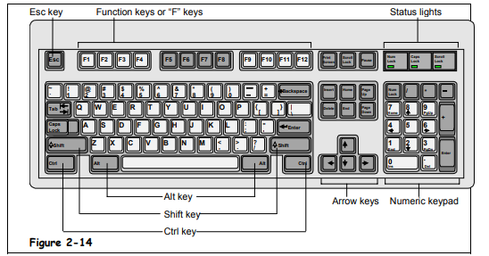
Keyboard
The keyboard of a computer resembles the keyboard of a typewriter.
It consists of
alphanumeric keys (letters and numbers),
punctuation keys (comma, colon, semicolon, etc),
special keys (control keys, arrow keys, function keys, etc).
These keys are placed in the ‘Q-W-E-R-T-Y' layout, similar to those in a typewriter.
When a key is pressed, electronic signals are generated. A keyboard encoder(also called keyboard controller) detects these signals and sends them to the CPU.
The most popular keyboard is the one with 101 keys.

Slide 24
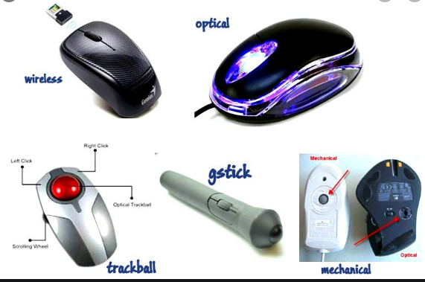
Mouse
The mouse is a handheld pointing device that controls the movement of the cursor or pointer on the monitor or the display screen.
It is connected to the computer system through a cable. A mouse has one to four buttons (usually two or three) and can be used for clicking on an icon, selecting a text or an object, dragging the selected items, etc.

Slide 25

Touchpad
In most of the laptop computers, the mouse is replaced by a touchpad.
A touchpad is a very small, touch sensitive device that is placed in front of the keyboard.
The movement of a finger placed on the touchpad moves the cursor on the screen.

Slide 26
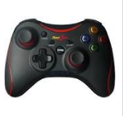
Joystick
A joystick is a controlling device which is most often used for playing computer games or controlling robots in the manufacturing industry.
It has a gearshift like lever which is used to move the pointer or cursor on the screen. Generally, joysticks are two dimensional with two sides of movement.

Slide 27
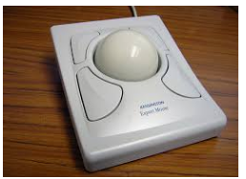
Trackball
trackball is a computer pointing device which can perform the same functions as a mouse.
Computer mice have small balls inside of them, and when a user moves the mouse, the ball rolls, causing the pointer on the screen to move. With a trackball, the user simply rolls the ball itself using her fingers or thumb, while the body of the device stays in place.

Slide 28
Difference Between Mouse and Trackball
 | Mouse | Trackball
1. | The mouse has to be moved when used. | The track ball Is stationary.
2. | A mouse consists of a metal or plastic housing or caring, a ball at its base and is rolled on a flat horizontal surface. | You use a trackball by the rolling the ball with your palm and fingers.
3. | It is popular among regular users. | It is mainly used for industrial purposes.
4. | Mouse is commonly use. It is less expensive compared to the trackball. | Trackball is rear use. It is an expensive input device.

Slide 29
Light pen
Light pens are pointing devices that resemble pens and are connected to the visual display unit.
Basically light pen used with cathode ray tube monitor.
These devices are used for selecting menu items or for drawing pictures.
A light pen consists of a small tube that contains a photocell and an optical system. When the tip of the pen touches the screen, the photocell sends the corresponding signal to the CPU indicating the screen location.

Slide 30
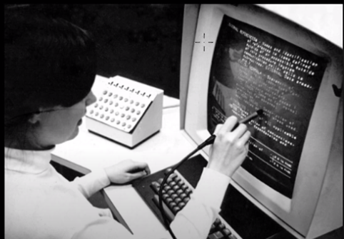
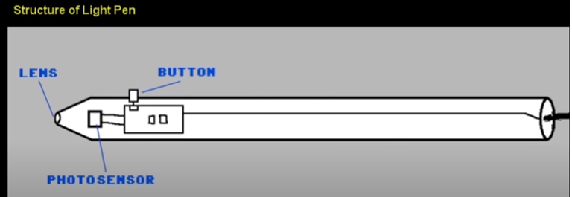
Light pen

Slide 31
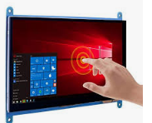
Touch screens
A touch screen is used in place of a keyboard. Touch screens recognize the human touch. Using them, users can point to the selection on the screen using their fingers.

Slide 32
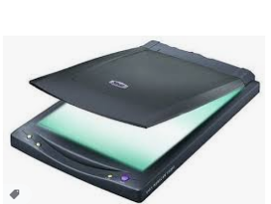
Scanners
Scanners are devices that are designed to copy anything that is printed on a sheet of paper.
They have the ability to analyze a picture or text and then convert it into a digital image.

Slide 33
Output Devices
Computer output devices receive information from the computer, and carry data that has been processed by the computer to the user.
Examples of Output Devices:-
Monitor –
This is the most common computer output device. It creates a visual display by the use of which users can view processed data. Monitors come in various sizes and resolutions.
Common Types of Monitors
CRT stands for Cathode Ray Tube. CRT is a technology used in traditional computer monitors and televisions. The image on CRT display is created by firing electrons from the back of the tube of phosphorus located towards the front of the screen.
Once the electron heats the phosphorus, they light up, and they are projected on a screen. The color you view on the screen is produced by a blend of red, blue and green light.

Slide 34
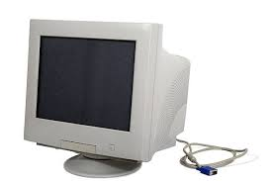
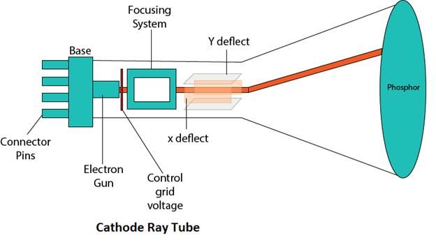

Slide 35
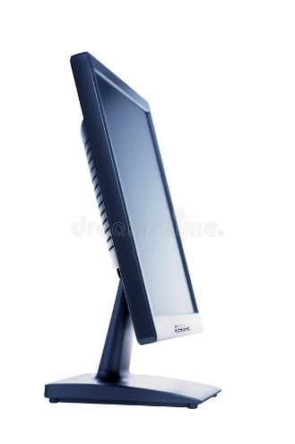
Flat Panel Screen – this makes use of liquid crystals or plasma to produce output. Light is passed through the liquid crystals in order to generate pixels.

Slide 36
Printer
This device generates a hard copy version of processed data, like documents and photographs. The computer transmits the image data to the printer, which then physically recreates the image, typically on paper.
Types of Printers
Ink Jet – this kind of printer sprays tiny dots of ink onto a paper to form an image. Cheaper but need to take print out frequently otherwise cartridge will dry and then changing cartridge frequently is costly.
The ink in the cartridges of these printers is in liquid form. They have nozzles from which ink is sprayed onto paper and it gets printed.
The disadvantage of these type of printers is that if you do not use it for a long time, then the ink in the cartridges gets dry. Then you have to clean it to use it again.
Example – HP Deskjet 1112 printer, Epson L130 single function printer, Epson L361 printer.

Slide 37
Printer
Laser - One of the big advantages of laser printers is that they don’t require ink.
Instead, laser printers use toner cartridges.
Toner is a very fine, dry powdered substance, which comes in cylindrical cartridges.
When a laser printer produces a document, it’s actually toner on the surface of the final printed page.
First, the laser printer reads the electronic data that makes up the information or image that you want to print and beams this onto a photo-sensitive drum.
The information on the drum is then transferred to paper using static electricity to position tiny particles of powdered toner in the correct pattern.

Slide 38
Printer
The toner powder is then permanently fused onto the paper by the heat and pressure from rollers inside the machine and your finished printout is ready.
They are more reliable in comparison to inkjet printers.
They don’t use nozzle and its ink is in the form of powder which is to be put in the given bar, that is why ink of these types of printers don’t dry up whether you use these once a year or you don’t use it at all.
Examples: HP Color LaserJet Pro MFP M479fdw
Canon MF232W

Slide 39
Printer
Dot Matrix – Dot matrix printing uses a print head that moves back-and-forth, or in an up-and-down motion, on the page and prints by impact, striking an ink-soaked cloth ribbon against the paper, much like the print mechanism on a typewriter.
It is used in printing passbook, railway tickets, mark sheets etc.

Slide 40
Speakers
speakers are attached to computers to facilitate the output of sound; sound cards are required in the computer for speakers to function.
The different kinds of speakers range from simple, two-speaker output devices right the way up to surround-sound multi-channel units.

Slide 41
There are some important CPU specifications and terms. Each term is important to understand and know when choosing a processor.
Multi-Core Technology
CPU Sockets and Chipsets
Frequency (Clock Rate)
Hyperthreading
Cache
Thermal Design Power (TDP)

Slide 42
Multi-core technology
A multicore processor is an integrated circuit that has two or more processor cores attached for enhanced performance and reduced power consumption.
These processors also enable more efficient simultaneous processing of multiple tasks, such as with parallel processing and multithreading.
By doing so, a multi-core CPU is allowed to do two things at once, rather than having to process one thing at a time. This significantly increases a processor’s performance.
A processor is like a computer's brain - and Intel® Core™ processors are the most powerful. They have multiple cores for more power and smoother multi-tasking. There are 4 main categories: i3, i5, i7 and i9. Each has numerous spec options, but strictly speaking i5 is superior to i3 and so on.

Slide 43
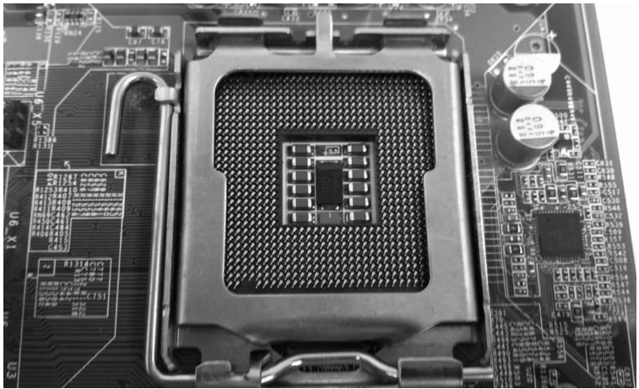
CPU Sockets and Chipsets
As processing technology advances, the two main CPU manufacturers (Intel and AMD) continually come out with new series of CPUs.
Along with different series’ of processors, there are also different sockets. The CPU socket is where the processor will be installed on the motherboard.
CPU socket is also called processor socket. Within CPU socket processor is installed and with the help of that socket, processor can communicate with other parts like hard disk, RAM etc.
When we connect wire to plug and it gets electricity and then it works same way when we connect CPU or processor with CPU socket (available on motherboard), processor is connected with all other parts available on motherboard.

Slide 44
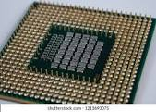
There are 3 types of sockets.
PGA- pin grad array (it uses small pins as connections, pins are available on CPU and holes are available on sockets)

Slide 45
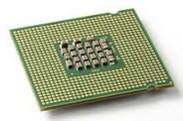
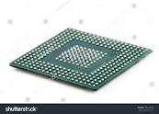
LGA- land grid array (pins are available on sockets and CPU has some contact points as shown below.)
Intel is using LGA.
BGA – ball grid array (balls are available on CPU and some space are available on socket to fit that CPU on socket, and CPU is permanently fixed with soldering on socket.)

Slide 46
For instance, Intel’s Core series of CPUs have gone through many sockets, including LGA 775, LGA 1156, LGA 1155, LGA 1150, and most recently, LGA 1151.
Example:
If you decide to buy an Intel Core i7 920 cpu, which is based on the LGA 1366, you have to buy a motherboard with a LGA 1366 socket for your cpu and motherboard to be compatible.

Slide 47
Operating Frequency (GHz)
CPU operating frequency, or clock rate, (which is measured in hertz).
The operating frequency of a processor is how fast it can complete a single cycle of work. The higher the frequency, the faster it can complete a single cycle of work.
A CPU with a clock speed of 3.2 GHz executes 3.2 billion cycles per second.
3.5 to 4.2 GHz is a good speed for processor.

Slide 48
Hyperthreading
Basically, hyperthreading allows the CPU to work on two different threads (sequences of instructions for the CPU to carry out) at the same time.
It allows the processor to work on two different things simultaneously.
It increases CPU performance by improving the processor’s efficiency, thereby allowing you to run multiple demanding apps at the same time or use heavily-threaded apps without the PC lagging.
Hyper-threading is currently available on Intel Core, Core vPro, Core M and Xeon processors.

Slide 49
Cache
Cache is on-board memory for your processor. It’s like RAM, but it offers even quicker access, since it’s located directly on your processor. While it only presents a small fraction of storage space as compared to your RAM and your hard drive, it is extremely fast and is used for the most important data relative to the tasks you are carrying out on your computer.
So, the more cache your processor has, the better overall it will perform.

Slide 50
Thermal Design Power
This is a general measurement that indicates how much power, in Watts, that your processor will consume in the worst case scenario. This is also used to have an idea of how much heat your processor will produce.
Same here, a lower number is desirable, to lower your electricity bill.
A processor which consumes more power and emit more heat will also need a better heatsink, or a faster fan, which usually results in a more noisy computer.
The lower the TDP of a processor, the less cooling it will need in order to operate at acceptable temperature levels.
The higher the TDP of a CPU and the more cooling you will need.

Slide 51
Storage Devices
A storage unit is a part of the computer system which is employed to store the information and instructions to be processed.
A storage device is an integral part of the computer hardware which stores information/data to process the result of any computational work. Without a storage device, a computer would not be able to run or even boot up. Or in other words, we can say that a storage device is hardware that is used for storing data files. It can also store information/data both temporarily and permanently.
Computer storage is of two types:
Primary Storage Devices: It is also known as internal memory and main memory. This is a section of the CPU that holds program instructions, input data, and intermediate results. It is generally smaller in size. RAM (Random Access Memory – voletile ) and ROM (Read Only Memor – non voletiley) are examples of primary storage.
Secondary Storage Devices: Secondary storage is a memory that is stored external to the computer. It is mainly used for the permanent and long-term storage of programs and data. Hard Disk, CD, DVD, Pen/Flash drive, SSD, etc, are examples of secondary storage.

Slide 52
Primary Storage Device
RAM: It stands for Random Access Memory. It is used to store information that is used immediately or we can say that it is a temporary memory.
Computers bring the software installed on a hard disk to RAM to process it and to be used by the user. Once, the computer is turned off, the data is deleted.
With the help of RAM, computers can perform multiple tasks like loading applications, browsing the web, editing a spreadsheet, experiencing the newest game, etc.
It allows you to modify quickly among these tasks, remembering where you’re in one task once you switch to a different task. It is also used to load and run applications, like your spreadsheet program, answer commands, like all edits you made within the spreadsheet, or toggle between multiple programs, like once you left the spreadsheet to see the email.
Memory is nearly always being actively employed by your computer. It ranges from 1GB – 32GB/64GB depending upon the specifications. There are different types of RAM, although they all serve the same purpose, the most common ones are :

Slide 53
Primary Storage Device
SRAM: It stands for Static Random Access Memory. It consists of circuits that retain stored information as long as the power is supply is on. It is also known as volatile memory.
It is used to build Cache memory. Acts as cache; storage measured in MBs
It is much faster as compared to DRAM but in terms of cost, it is costly as compared to DRAM.
DRAM: It stands for Dynamic Random Access Memory.
Connects directly to CPU bus, volatile storage measured in GBs
The access time of DRAM is slower as compare to SRAM and it is cheaper than SRAM
SDRAM: It stands for Synchronous Dynamic Random Access Memory. It is faster than DRAM. It is widely used in computers and others. After SDRAM was introduced, the upgraded version of double data rate RAM, i.e., DDR1, DDR2, DDR3, and DDR4 was entered into the market and widely used in home/office desktops and laptops.

Slide 54
Primary Storage Device
ROM: It stands for Read-Only Memory.
The data written or stored in these devices are non-volatile, i.e, once the data is stored in the memory cannot be modified or deleted.
The memory from which will only read but cannot write it. This type of memory is non-volatile. The information is stored permanently during manufacture only once.
ROM stores instructions that are used to start a computer. This operation is referred to as bootstrap.
It is also used in other electronic items like washers and microwaves. ROM chips can only store few megabytes (MB) of data, which ranges between 4 and 8 MB per ROM chip. There are two types of ROM:
PROM: PROM is Programmable Read-Only Memory. These are ROMs that can be programmed. A special PROM programmer is employed to enter the program on the PROM. Once the chip has been programmed, information on the PROM can’t be altered. PROM is non-volatile, that is data is not lost when power is switched off.
EPROM: Another sort of memory is that the Erasable Programmable Read-Only Memory. It is possible to erase the info which has been previously stored on an EPROM and write new data onto the chip.

Slide 55
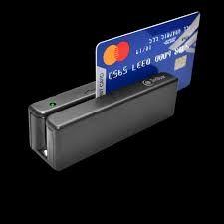
Examples of Storage Device
Magnetic Storage Device – one of the most popular types of storage used.
Floppy diskette – It is also known as a floppy diskette. It is generally used on a personal computer to store data externally. A Floppy disk is made up of a plastic cartridge and secures with a protective case.
A normal 3 ½ inch disk can store 1.44 MB of data.
Hard drive – An internal hard drive is the main storage device in a computer. An external hard drive is also known as removable hard drive. It is used to store portable data and backups. It ranges from a few GBs to a few and more TB.
Magnetic card – It is a card in which data is stored by modifying or rearranging the magnetism of tiny iron-based magnetic particles present on the band of the card. It is also known as a swipe card. It is used like a passcode(to enter into house or hotel room), credit card, identity card, etc.

Slide 56
Optical Storage Device – uses lasers and lights as its mode of saving and retrieving data.
Blu-ray disc – It is just like CD and DVD but the storage capacity of blu ray is up to 25GB. To run a Blu-ray disc you need a separate Blu-ray reader.
CD disc – It is known as Compact Disc. It contains tracks and sectors on its surface to store data. It is made up of polycarbonate plastic and is circular in shape. CD can store data up to 700MB. It is of two types:
CD-R: It stands for Compact Disc read-only. In this type of CD, once the data is written can not be erased. It is read-only.
CD-RW: It stands for Compact Disc read Write. In this type of CD, you can easily write or erase data multiple times.
DVD: It is known as Digital Versatile Disc. DVDs are circular flat optical discs used to store data. It comes in two different sizes one is 4.7GB single-layer discs and another one is 8.5GB double-layer discs. DVDs look like CDs but the storage capacity of DVDs is more than as compared to CDs. It is of two types:
DVD-R: It stands for Digital Versatile Disc read-only. In this type of DVD, once the data is written can not be erased. It is read-only. It is generally used to write movies, etc.
DVD-RW: It stands for Digital Versatile Disc read Write. In this type of DVD, you can easily write or erase data multiple times.

Slide 57
Flash Memory Device –It is the most commonly used device to store data because is more reliable and efficient as compare to other storage devices.
SSD – Solid State Drive – It stands for Solid State Drive, a mass storage device like HDDs. It is more durable because it does not contain optical disks inside like hard disks. It needs less power as compared to hard disks, is lightweight, and has 10x faster read and write speed as compared to hard disks. But, these are costly as well.
Pen Drive: It is also known as a USB flash drive that includes flash memory with an integrated USB interface. We can directly connect these devices to our computers and laptops and read/write data into them in a much faster and efficient way. These devices are very portable. It ranges from 1GB to 256GB generally.

Slide 58
Flash Memory Device –
Multimedia Card: It is also known as MMC. It is an integrated circuit that is generally used in-car radios, digital cameras, etc. It is an external device to store data/information. Storage is up to 32 MB.
Memory Card: A memory card is a type of storage device that is used for storing media and data files.
It provides a permanent and non-volatile medium to store data and files from the attached device.
Memory cards are commonly used in small, portable devices, such as cameras and phones. It is also used to store large amounts of data and is available in different sizes. To run a memory card on a computer you require a separate memory card reader.
An electronic flash memory device used to store digital information and commonly used in mobile electronic devices.

Slide 59
Online and Cloud :Data is managed remotely and made available over a network. Basic features are free to use but upgraded version is paid monthly as a per consumption rate. Unlike a USB drive, external hard drive, or flash drive, users do not need to carry around a physical device to store their data. They just have to remember a password and access the data anywhere.
Online storage is a viable option for data backup: it provides both security and convenience to the end user

Slide 60
Paper Storage – method used by early computers for saving information.
OMR – stands for Optical Mark Recognition A process of capturing marked data of human from forms like surveys and tests. It is used to read questionnaires with multiple choices that are shaded.
Punch card – Punch cards (or "punched cards"), also known as Hollerith cards or IBM cards, are paper cards where holes may be punched by hand or machine to represent computer data and instructions.
They were a widely-used means of inputting data into early computers. The cards were fed into a card reader connected to a computer, which converted the sequence of holes to digital information.

Slide 61
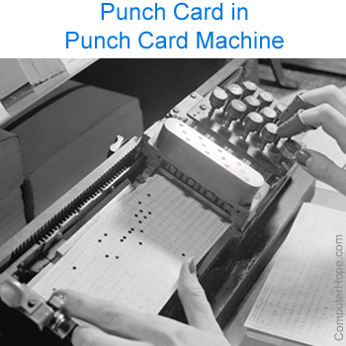
For example, an early computer programmer would write a program by hand, then convert the program to several punched cards using a punch card machine. The programmer would then take the stack of cards to a computer and feed the cards into a card reader to input the program. Picture is an example of a woman using a punch card machine to create a punch card.

Slide 62
Booting
Booting is basically the process of starting the computer.
When the CPU is first switched on it has nothing inside the Memory.
In order to start the Computer, load the Operating System into the Main Memory and then Computer is ready to take commands from the User.

Slide 63
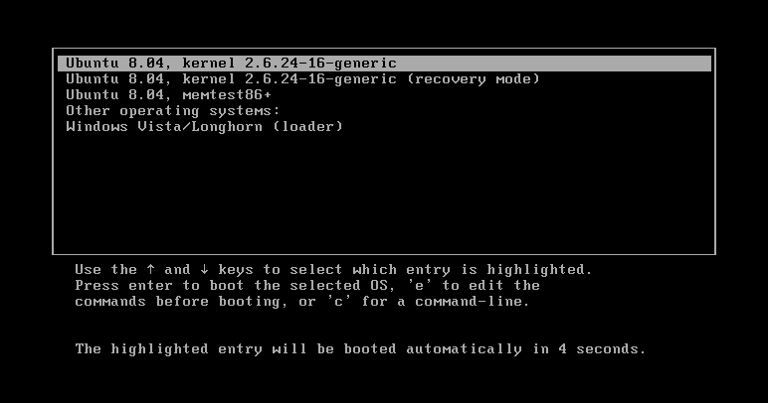
What happens in the Process of Booting?
Booting happens when you start the computer. This happens when we turned ON the power or the computer restarts. The system BIOS (Basic Input/Output System) makes the peripheral devices active. Further, it requires that the boot device loads the operating system into the main memory.

Slide 64
BIOS
A computer's BIOS (basic input/output – typically stored on EPROM) is its motherboard firmware (Firmware is a type of software that is fixed directly into a piece of hardware. ), the software which runs at a lower level than the operating system and tells the computer what drive to boot from RAM you have and controls other key details like CPU frequency. You can go into the BIOS menu to change your boot order.
In order to access BIOS on a Windows PC, you must press your BIOS key set by your manufacturer which could be F10, F2, F12, F1, or DEL.
If your PC goes through its power on self-test startup too quickly, you can also enter BIOS through Windows 10’s advanced start menu recovery settings.

Slide 65
Boot Devices
Booting can be done either through hardware (pressing the start button) or by giving software commands.
Therefore, a boot device is a device that loads the operating system.
Moreover, it contains the instructions and files which start the computer.
Examples are the hard drive, floppy disk drive, CD drive, etc. Among them, the hard drive is the most used one.

Slide 66
Types of Booting
There are two types of booting:
Cold Booting
A cold boot is also called a hard boot. It is the process when we first start the computer.
In other words, when the computer is started from its initial state by pressing the power button it is called cold boot.
The instructions are read from the ROM and the operating system is loaded in the main memory.
Warm Booting
Warm Boot is also called soft boot.
It refers to when we restart the computer.
Here, the computer does not start from the initial state.
When the system gets stuck sometimes it is required to restart it while it is ON.
Therefore, in this condition the warm boot takes place. Restart button or CTRL+ALT+DELETE keys are used for warm boot.

Slide 67
Steps of Booting
We can describe the boot process in six steps:
1. The Startup
It is the first step that involves switching the power ON. It supplies electricity to the main components like BIOS and processor.
2. BIOS: Power On Self Test
It is an initial test performed by the BIOS.
Further, this test performs an initial check on the input/output devices, computer’s main memory, disk drives, etc. Moreover, if any error occurs, the system produces a beep sound.
3. Loading of OS
In this step, the operating system is loaded into the main memory. The operating system starts working and executes all the initial files and instructions.

Slide 68
Steps of Booting
4. System Configuration
In this step, the drivers are loaded into the main memory. Drivers are programs that help in the functioning of the peripheral devices.
5. Loading System Utilities
System utilities are basic functioning programs, for example, volume control, antivirus, etc. In this step, system utilities are loaded into the memory.
6. User Authentication
If any password has been set up in the computer system, the system checks for user authentication. Once the user enters the login Id and password correctly the system finally starts.

Slide 69
Computer Name
A computer name is a unique identifier that is given to each computer and is used to locate and connect to a computer in order to perform routine maintenance, as well as provide remote technical assistance.
Computer names are also required for those employees who wish to remote into their office machine from another location; such as from home.
All computer names are set up in a standard format that contains location and identifying information. You can locate the computer name of a PC by completing the following steps:

Slide 70
Computer Name
On the desktop, right-click the Computer icon and select Properties from the menu that appears.
In the dialog box that appears, the full computer name can be located in the Computer Name, Domain, and Workgroup Settings section.
Or open command prompt and then type hostname command it will also display computer name.

Slide 71
Workgroup
A workgroup is a peer-to-peer network using Microsoft software. A workgroup allows all participating and connected systems to access shared resources such as files, system resources and printers.

Slide 72
What is the difference between a domain and a workgroup?
Computers on a network can be part of a workgroup or a domain. The main difference between workgroups and domains is how resources on the network are managed. Computers on home networks are usually part of a workgroup, and computers on workplace networks are usually part of a domain.
In a workgroup:
All computers are peers; no computer has control over another computer.
Each computer has a set of user accounts. To use any computer in the workgroup, you must have an account on that computer.
All computers must be on the same local network.
In a domain:
One or more computers are servers. Network administrators use servers to control the security and permissions for all computers on the domain. This makes it easy to make changes because the changes are automatically made to all computers.
If you have a user account on the domain, you can log on to any computer on the domain without needing an account on that computer.
There can be hundreds or thousands of computers.
The computers can be on different local networks.
Due to the increase security and manageability in a domain environment it is always recommended to implement a domain environment for our clients

Slide 73
IP
An IP address is a unique address that identifies a device on the internet or a local network. IP stands for "Internet Protocol," which is the set of rules governing the format of data sent via the internet or local network.
In essence, IP addresses are the identifier that allows information to be sent between devices on a network: they contain location information and make devices accessible for communication. The internet needs a way to differentiate between different computers, routers, and websites.
An IP address is a string of numbers separated by periods. IP addresses are expressed as a set of four numbers — an example address might be 192.158.1.38. Each number in the set can range from 0 to 255. So, the full IP addressing range goes from 0.0.0.0 to 255.255.255.255.

Slide 74
Find IP Address
First, click on your Start Menu and type cmd in the search box and press enter.
Type ipconfig /all and press enter. There is a space between the command ipconfig and the switch of /all. Your ip address will be the IPv4 address.
Another way to find IP address is, type network and sharing center in run, click local area connection, then click details, IPv4 is your IP address.

Slide 75
DNS
The Domain Name System (DNS) is the phonebook of the Internet. Humans access information online through domain names, like nytimes.com or espn.com. Web browsers interact through Internet Protocol (IP) addresses. DNS translates domain names to IP addresses so browsers can load Internet resources.
Each device connected to the Internet has a unique IP address which other machines use to find the device. DNS servers eliminate the need for humans to memorize IP addresses such as 192.168.1.1

Slide 76
How DNS works
DNS servers convert URLs and domain names into IP addresses that computers can understand and use.
They translate what a user types into a browser into something the machine can use to find a webpage. This process of translation and lookup is called DNS resolution.

Slide 77
How DNS works
The basic process of a DNS resolution follows these steps:
1. The user enters a web address or domain name into a browser.
2. The browser sends a message, called a recursive DNS query, to the network to find out which IP or network address the domain corresponds to.
3. The query goes to a recursive DNS server, which is also called a recursive resolver, and is usually managed by the internet service provider (ISP). If the recursive resolver has the address, it will return the address to the user, and the webpage will load.
4. If the recursive DNS server does not have an answer, it will query a series of other servers in the following order: DNS root name servers, top-level domain (TLD) name servers and authoritative name servers.

Slide 78
How DNS works
5. The three server types work together and continue redirecting until they retrieve a DNS record that contains the queried IP address. It sends this information to the recursive DNS server, and the webpage the user is looking for loads. DNS root name servers and top-level domain (TLD) servers primarily redirect queries and rarely provide the resolution themselves.
6. The recursive server stores, or caches, the record for the domain name, which contains the IP address. The next time it receives a request for that domain name, it can respond directly to the user instead of querying other servers.
7. If the query reaches the authoritative server and it cannot find the information, it returns an error message.

Slide 79
Proxy server
Proxy servers work by facilitating web requests and responses between a user and web server.
Typically, a user accesses a website by sending a direct request to its web server from a web browser via their IP address. The web server then sends a response containing the website data directly back to the user.

Slide 80
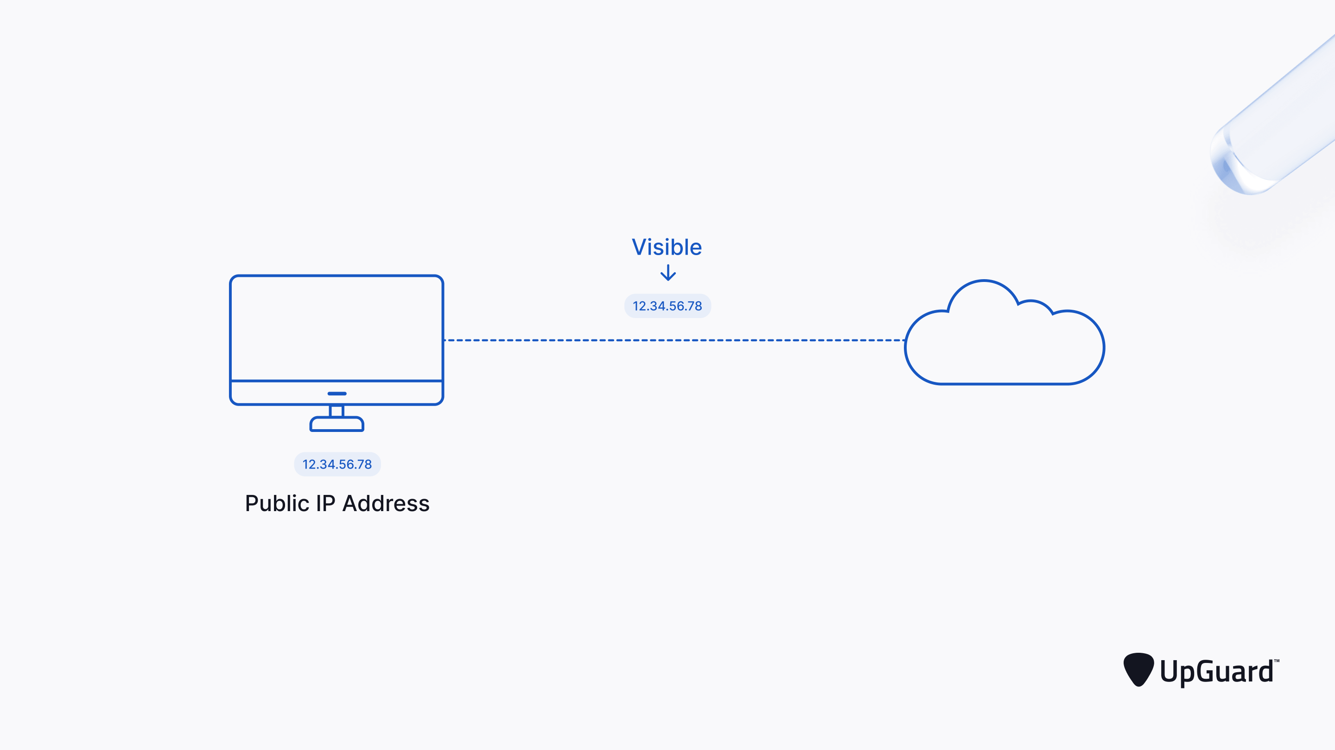
Proxy server

Slide 81
Proxy server
A proxy server acts as an intermediary between the user and the web server. Proxy servers use a different IP address on behalf of the user, concealing the user's real address from web servers.
A standard proxy server configuration works as follows:
A user enters a website's URL into their browser.
The proxy server receives the user's request.
The proxy server forwards the request to the web server.
The web server sends a response (website data) back to the proxy server.
The proxy server forwards the response to the user.

Slide 82
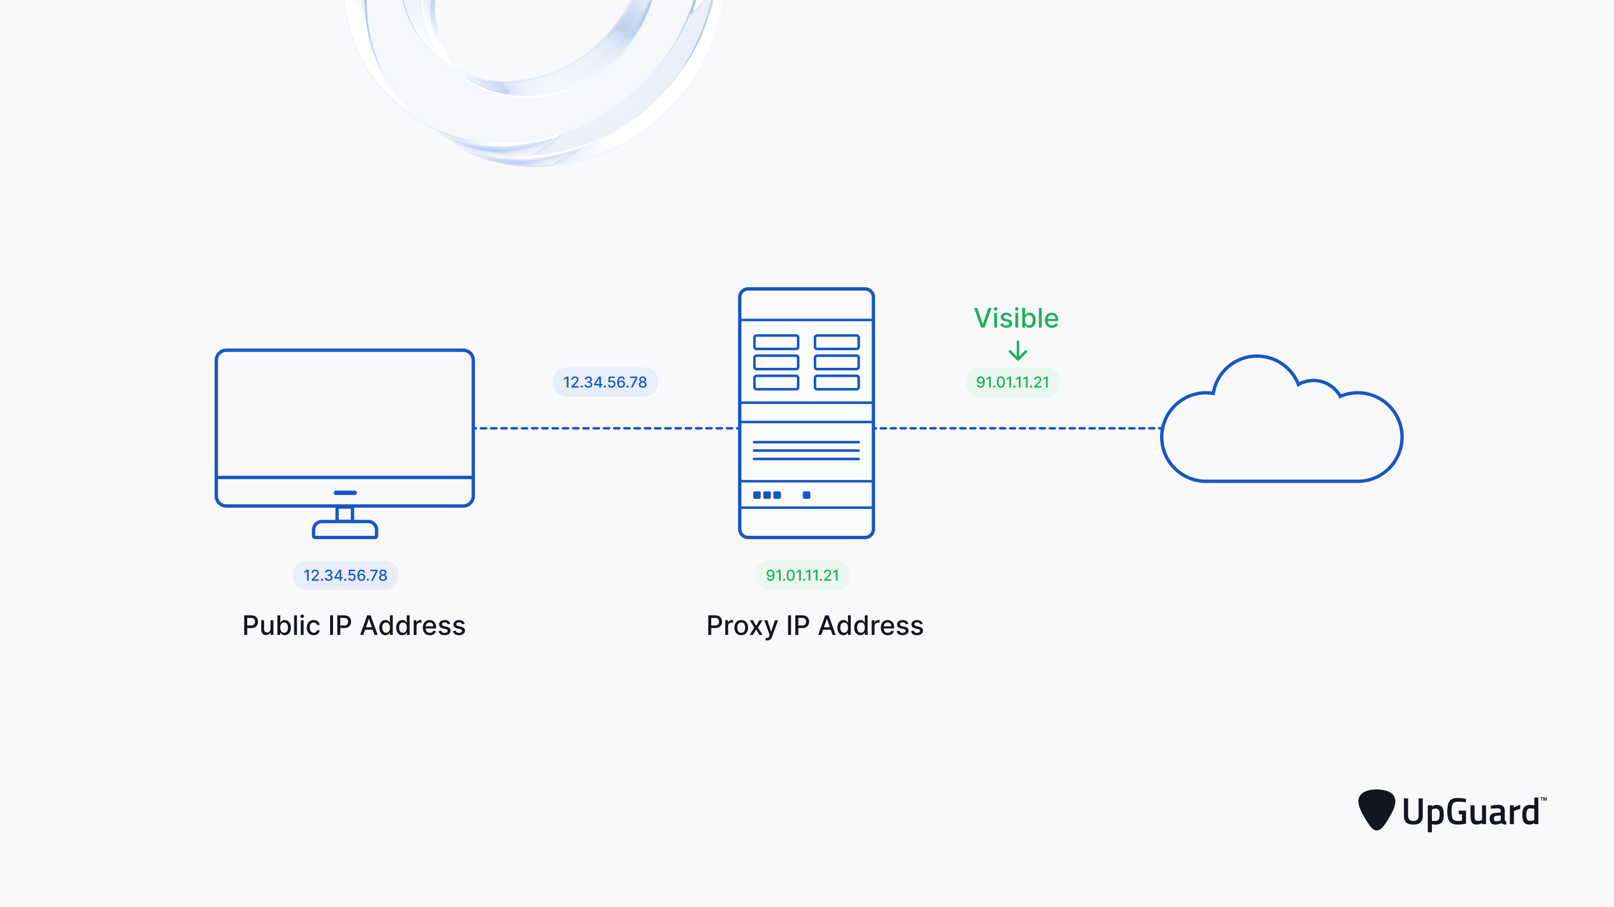
Proxy server

Slide 83
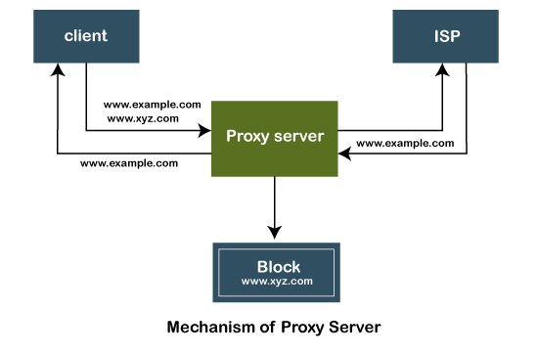
Mechanism of Proxy Server

Slide 84
Mechanism of Proxy Server
The proxy server accepts the request from the client and produces a response based on the following conditions:
If the requested data or page already exists in the local cache, the proxy server itself provides the required retrieval to the client.
If the requested data or page does not exist in the local cache, the proxy server forwards that request to the destination server.
The proxy servers transfer the replies to the client and also being cached to them.
Therefore, it can be said that the proxy server acts as a client as well as the server.

Slide 85
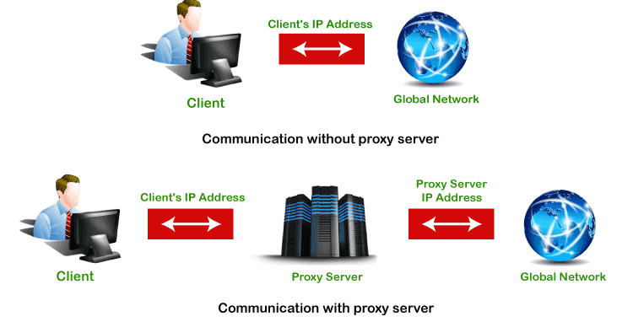
Mechanism of Proxy Server

Slide 86
Password
Start > Control Panel or Start > Settings > Control Panel.
Click on User Accounts. Then click change your windows password. Enter your current Windows password, then enter the new password and confirm it.
Click Change your password in the User Account Window.

Slide 87
Users
A user account allows you to sign in to your computer.
By default, your computer already has one user account, which you were required to create when you set up your computer.
If you plan to share your computer with others, you can create a separate user account for each person.

Slide 88
Why use separate user accounts?
At this point, you may be wondering why you would even need to use separate user accounts.
But if you're sharing a computer with multiple people—for example, with your family or at the office—user accounts allow everyone to save their own files, preferences, and settings without affecting other computer users.
When you start your computer, you'll be able to choose which account you want to use.

Slide 89
Users
Select the Windows Start menu button.
Select Control Panel .
Select User Accounts .
Select Manage another account .
Select Create a new account .
In the New Account Name text box, type a name for the new account.
Click Create Account .

Slide 90
Basic troubleshooting of a computer system
Troubleshooting is the process of identifying and solving technical problems. It starts with general issues and then gets more specific.
Problem: An application is running slowly
Solution 1: Close and reopen the application.
Solution 2: Update the application.

Slide 91
Problem: An application is frozen
Sometimes an application may become stuck, or frozen. When this happens, you won't be able to close the window or click any buttons within the application.
Solution 1: Force quit the application. On a PC, you can press Alt+f4
Solution II:Ctrl+Alt+Delete (the Control, Alt, and Delete keys) on your keyboard to open the Task Manager. On a Mac, press and hold Command+Option+Esc. You can then select the unresponsive application and click End task (or Force Quit on a Mac) to close it.

Slide 92
Problem: All programs on the computer run slowly
Solution 1: Run a virus scanner.
Solution 2: Your computer may be running out of hard drive space. Try deleting any files or programs you don't need.
Solution 3: You can run Disk Defragmenter.

Slide 93
Problem: The mouse or keyboard has stopped working
Solution 1: If you're using a wired mouse or keyboard, make sure it's correctly plugged into the computer.
Solution 2: If you're using a wireless mouse or keyboard, make sure it's turned on and that its batteries are charged.

Slide 94
Problem: If Audio is not working properly
Solution 1: Check the volume level. Click the audio button in the top-right or bottom-right corner of the screen to make sure the sound is turned on and that the volume is up.
Solution 2: Check the audio player controls. Many audio and video players will have their own separate audio controls. Make sure the sound is turned on and that the volume is turned up in the player.
Solution 3: Check the cables. Make sure external speakers are plugged in, turned on, and connected to the correct audio port or a USB port. If your computer has color-coded ports, the audio output port will usually be green.
Solution 4: Connect headphones to the computer to find out if you can hear sound through the headphones.

Slide 95
Problem: The screen is blank
Solution 1: The computer may be in Sleep mode. Click the mouse or press any key on the keyboard to wake it.
Solution 2: Make sure the monitor is plugged in and turned on.
Solution 3: Make sure the computer is plugged in and turned on.
Solution 4: If you're using a desktop, make sure the monitor cable is properly connected to the computer tower and the monitor.

Slide 96
Slow Internet To improve your Internet browser performance, you need to clear cookies and Internet temporary files frequently. In the Windows search bar, type ‘%temp%’ and hit enter to open the temporary files folder. Clearing the Temp folder is a standard procedure for system administration to reduce the amount of storage space used.
Overheating If a computer case lacks a sufficient cooling system, then the computer’s components may start to generate excess heat during operation. To avoid your computer burning itself out, turn it off and let it rest if it’s getting hot. Additionally, you can check the fan to make sure it’s working properly.
Dropped Internet Connections Dropped Internet connections can be very frustrating. Often the problem is simple and may be caused by a bad cable or phone line, which is easy to fix. More serious problems include viruses, a bad network card or modem, or a problem with the driver.

Slide 97
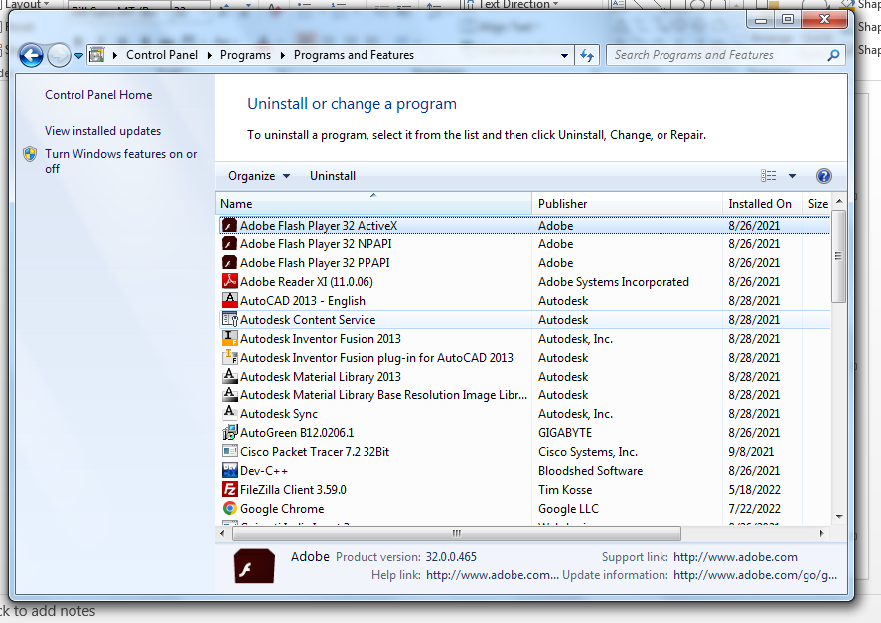
Optimizing the computer performance
Uninstall unnecessary software
If you don’t need any software then uninstall it. Go to control panel -> programs -> uninstall a program

Slide 98
Optimizing the computer performance
Limit the programs at startup
Not all programs loaded automatically when the system starts can be found in the Startup folder.
You have to access the System Configuration to deactivate these programs.
Using the “Run” dialog is the fastest way to access the required list. To open it, press [Win] + [R] and enter “msconfig”.
The window that opens contains a tab called “Startup”. It contains a list of all programs that are launched automatically when the system starts.

Slide 99
Optimizing the computer performance
Once you find the program you don’t want to run on startup, you can disable the automatic start setting by unchecking the checkbox.
Windows even lets you deactivate all applications at once. However, take care when using this option:
Some of the programs may play an important role in keeping your PC functioning properly.
The program remains visible in the list after deactivation, which makes it easy to undo your decision.
The programs in the Startup folder should be based on your individual requirements. You can load all the programs you use every time when the system starts. Ex. Anivirus, back up software etc.

Slide 100
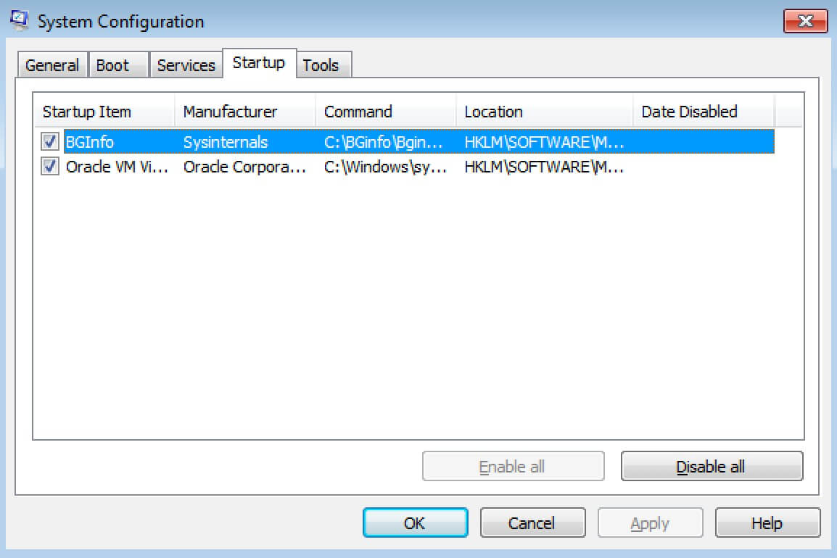
Optimizing the computer performance

Slide 101
Optimizing the computer performance
Add more RAM to your PC
This will increase speed of the PC.
Check for spyware and viruses
use antivirus software.
Use Disk Cleanup and defragmentation
Disk Cleanup
Disk Cleanup is a Microsoft software utility first introduced with Windows 98 and included in all subsequent releases of Windows. It allows users to remove files that are no longer needed or that can be safely deleted.

Slide 102
Optimizing the computer performance
Disk Cleanup
Removing unnecessary files, including temporary files, helps speed up and improve the performance of the hard drive and computer. Running Disk Cleanup at least once a month is an excellent maintenance task and frequency.
Disk Cleanup can delete temporary Internet files, downloaded program files, and offline webpages. Disk Cleanup also allows you to empty the Recycle Bin, delete temporary files, and delete thumbnails.

Slide 103
Optimizing the computer performance
How to open Microsoft Disk Cleanup
Windows 10 and Windows 8
Press Windows key+X to open the Power User Task Menu.
In the menu, tap or click the Run option.
In the Run text field, type cleanmgr and press Enter.
Windows 7 and earlier
Open the Start menu.
Click Programs > Accessories > System Tools.
In System Tools, click the Disk Cleanup utility.
or
Open the Start menu.
Click the Run option.
In the Run text field, type cleanmgr and press

Slide 104
Optimizing the computer performance
Once Disk Cleanup opens, the initial window asks you which drive you want to clean up.
Select the appropriate drive and click OK.
In the next window that opens, check each of the boxes you want to clean up.
To the right of each item is the disk drive space each of the items are taking up on the hard drive.
Once each of the boxes is checked, click OK to start the cleanup process.

Slide 105
Optimizing the computer performance
What is defragmentation and why do I need it?
Defragmentation, also known as “defrag” or “defragging”, is the process of reorganizing the data stored on the hard drive so that related pieces of data are put back together, all lined up in a continuous fashion.
You could say that defragmentation is like cleaning house for your Servers or PCs, it picks up all of the pieces of data that are spread across your hard drive and puts them back together again, nice and neat and clean.
Defragmentation increases computer performance.

Slide 106
Optimizing the computer performance
How Fragmentation Occurs
Disk fragmentation occurs when a file is broken up into pieces to fit on the disk.
Because files are constantly being written, deleted and resized, fragmentation is a natural occurrence.
When a file is spread out over several locations, it takes longer to read and write resulting in slow computer performance.

Slide 107
Optimizing the computer performance
How to do disk defragmentation
Allow Disk Defragmenter to run automatically
open control panel -> system and security -> administrative tools -> defragment your hard drive -> configure schedule -> then enter day and time and frequency when you want to run defragmentation automatically.

Slide 108
Optimizing the computer performance
2. Manually run Disk Defragmenter
Click the Start menu or Windows button
Select Control Panel, then System and Security
Under Administrative Tools, click Defragment your hard drive
Select Analyze disk. The report you get will indicate if you need to defrag your disk.
If you need to manually defrag your disk, click Defragment disk

Slide 109
Optimizing the computer performance
Consider a startup SSD
When you want better performance, a startup solid-state drive (SSD) can go a long way toward taking some of the pressure off the processor when your computer boots up.
If you tend to run a number of applications at one time or use photo and video editing software, then a startup drive can go a long way toward making these programs run smoother and load faster.
While they’re most commonly installed on desktop computers, SSDs can be used on some laptop models as well. When you don’t have the option of using an internal SSD, you can always purchase an external drive that connects to your PC with a USB.
This drive can give you the extra push you need at startup to accomplish tasks and give you a boost for apps that need more temporary memory to run properly.

Slide 110
Optimizing the computer performance
Take a look at your web browser
If you have a full cache that has not been emptied in a while, then you’ll want to visit your settings and make sure that it’s empty.
Your cache includes what you pick up when you are visiting various websites.
Many sites use cookies in order to figure out your browsing habits and the ads you may click when you visit a site will leave one too.
A cache holds these files as information and if you spend a lot of time online, these files can accumulate and cause your computer to run more slowly.

Slide 111
Optimizing the computer performance
There are two ways to do this in the more popular web browsers:
For Internet Explorer:
Visit “Internet Options”
Click on the “General” tab
Look for the “Browsing History” option
Select “Temporary Internet Files” and “Website Data”
Hit “Delete”
For Google Chrome:
Visit “More settings”
Select “More tools”
Click “Clear browsing data”
Note that Chrome allows you to delete data within a certain time period
If you’ve never deleted the files in your cache before, you’ll want to select “All time”
Check the boxes “Cookies and other site data” and “Cached images and files”
Hit “Clear data”

Slide 112
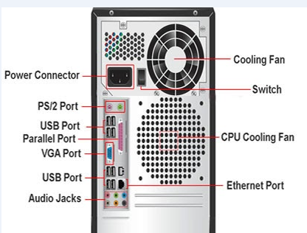
Plug and Play concepts

Slide 113
Types of Computer Ports
A computer is a device that transforms data into meaningful information.
It processes the input according to the set of instructions provided to it by the user and gives the desired output.
As we know that we can connect multiple external devices with the computer system.
Now, these devices are connected with the computer using Ports.
The ports are the physical points present in the computer through which the external devices are connected using cables.
Or in other words, a port is an interface between the motherboard and an external device of the computer.

Slide 114
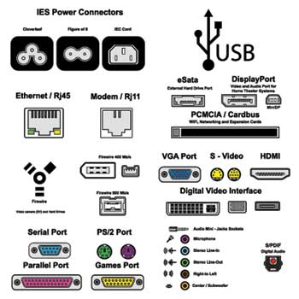
Types of Computer Ports

Slide 115
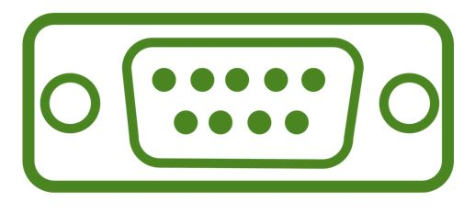
Types of Computer Ports
Serial port(COM Port):
A serial port is also called a communication port and they are used for connection of external devices like a modem, mouse, or keyboard (basically in older PCs).
It transfers information one bit at a time between the computer and external peripherals.
Serial cables are cheaper to make in comparison to parallel cables and they are easier to shield from interference.
There are two versions of it, which are 9 pin model and 25 pin model.
It transmits data at 115 KB/sec.

Slide 116
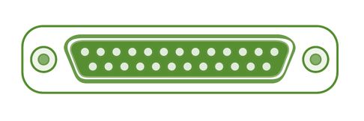
Types of Computer Ports
Parallel Port (LPT ports):
Parallel ports are generally used for connecting scanners and printers.
It can send several bits at the same time as it uses parallel communication.
Its data transfer speed is much higher in comparison with the serial port.
It is a 25 pin model. It is also known as Printer Port or Line Printer Port.

Slide 117
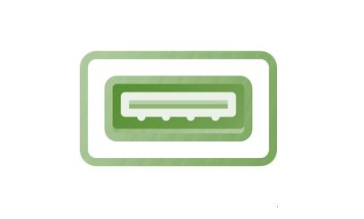
Types of Computer Ports
USB (Universal Serial Bus):
In 1997 USB was first introduced.
This can connect all kinds of external USB devices, like external hard disk, printer, scanner, mouse, keyboard, etc.
There are minimum of two USB Ports provided in most of the computer systems.
It is a kind of new type serial connection Port that is much faster than the old serial Ports and These USB Ports are much smarter and more versatile.
USB ports can be used as a power supply for different devices like cellphones, cameras, laptop coolers and more.

Slide 118
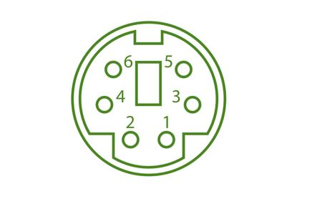
Types of Computer Ports
PS/2 Port:
PS/2 ports are special ports used for connecting old computer keyboard and mouse.
It was invented by IBM.
In old computers, there are minimum of two PS/2 Ports, each for the keyboard and the mouse. It is a 6 pin mini Din connector.

Slide 119
Types of Computer Ports
VGA Port:
VGA ports also known as Video Graphic Array connector are those which connect the monitor to a computer’s video card.
It is used for connecting the monitor with the video adapter from the computer motherboard to display video on your monitor.
VGA port has 15 holes and it is similar to the serial port connector. But VGA Ports have holes in it and the serial port connector has pins in it.

Slide 120

Types of Computer Ports
Sockets:
Microphones and speakers are connected with the help of Sockets to the sound card of the computer.

Slide 121
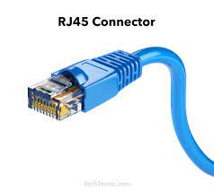
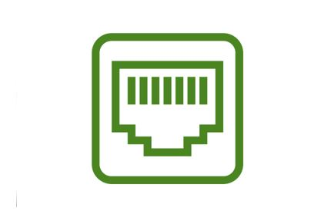
Types of Computer Ports
Ethernet/Internet Port:
Ethernet Port helps to connect to a network and high-speed Internet(provided by LAN or other sources).
It connects the network cable to a computer and resides in a Ethernet card.
They were first introduced in 1980 to standardize the local area networks (LAN).
Internet ports use RJ45 connectors and have speeds between 10 Mb/sec – 100 Mb/sec – 1 Gb/sec – 40 Gb/sec – 100 Gb/sec.
An RJ45 cable is primarily used to connect devices over an Ethernet. For example, computers, printers, network storage devices etc. , are some devices capable of using an RJ45 connection. Being able to identify an RJ45 cable is important when attempting to connect devices to a network.

Slide 122
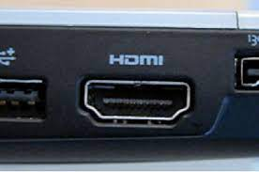
Types of Computer Ports
HDMI (High Definition Multimedia Interface): Ports on computer to transmit High Definition (1080p+) Video from the computer video card to the monitor.

Slide 123
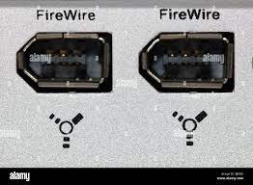
Types of Computer Ports
Firewire Port
Transfers large amount of data at very fast speed.
Data travels at 400 to 800 megabits per seconds.
Invented by Apple.
It has three variants: 4-Pin FireWire 400 connector, 6-Pin FireWire 400 connector, and 9-Pin FireWire 800 connector.
Along with USB, Firewire (also called IEEE 1394) is another popular connector for adding peripherals to your computer.
Firewire is most often used to connect digital camcorders, external hard drives, and other devices that can benefit from the high transfer rates (up to 480 Mbps) supported by the Firewire connection.
Most modern computers don't have FireWire ports built-in. You'd have to upgrade them, which costs extra and may not be possible on every computer. The most recent USB standard is USB4, which supports transfer speeds as high as 40,960 Mbps. It's much faster than the 800 Mbps that FireWire supports.

Slide 124
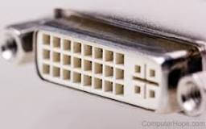
Types of Computer Ports
DVI Port (Digital Visual Interface)
Common devices that utilize the DVI connection are computer monitors and projectors.
DVI offers a distinctly sharper, better picture than VGA.
DVI can even be used with some TVs, although HDMI is more common as only some DVI cables can transmit video signals.

Slide 125
Working with Internet Drive Storage
Online data storage refers to the practice of storing electronic data with a third party service accessed via the Internet.
It is an alternative to traditional local storage (such as disk or tape drives) and portable storage (such as optical media or flash drives).
It can also be called “hosted storage,” “Internet storage” or “cloud storage.”
In recent years, the number of vendors offering online data storage for both consumers and businesses has increased dramatically.
Some services store only a particular kind of data, such as photos, music or backup data, while others will allow users to store any type of file.
Most of these vendors offer a small amount of storage for free with additional storage capacity available for a fee, usually paid on a monthly or annual basis.

Slide 126
BENEFITS OF ONLINE STORAGE
One of the biggest benefits of online storage is the ability to access data from anywhere.
As the number of devices the average person uses continues to grow, syncing or transferring data among devices has become more important.
Not only does it help transfer data between devices, online data storage also provides the ability to share files among different users.
This is particularly helpful for business users, although it’s also popular with consumers who want to share photos, videos and similar materials with their friends and family.
Online data storage also offers distinct advantages for backup and disaster recovery situations because it’s located off site.
In a fire, flood, earthquake or similar situation, on-site backups could be damaged, but online backups won’t be affected unless the disaster is very widespread.
However, online data storage does have some potential downsides.
Some people worry about the security of cloud storage services, and some vendors have experienced significant outages from time to time, leading to concerns about reliability.

Slide 127
ONLINE STORAGE ENHANCES DATA PROTECTION AND AVAILABILITY
Before the development of the Internet, computer systems were limited to local storage or portable storage, first in the form of tapes and floppy disks, then CDs, DVDs and USB thumb drives. Generally, using on-site storage is faster than using Internet storage, because you don’t have to wait for files to upload or download.
However, on-site storage is more susceptible to loss due to theft, natural disasters or device failure.
By contrast, most online data storage facilities offer enhanced physical security and automated backup capabilities to ensure that data is not lost. Online data storage also enables easier data transfer and sharing.
Like local storage, portable storage devices offer fast data transfer along with some data transfer and sharing capabilities.
However, portable storage isn’t quite as convenient as online data storage, particularly if you want to share files with a large number of users. Portable storage devices are also easy to lose or damage, and they offer limited storage capacity.

Slide 128
ONLINE STORAGE ENHANCES DATA PROTECTION AND AVAILABILITY
Recently, the term cloud storage has become increasingly common.
Although many people use the terms “cloud storage” and “online storage” interchangeably, technically, cloud storage is a particular kind of online data storage.
Many individuals and organizations use a mix of on-site and online storage capabilities.
For example, they might use local storage for files they use frequently and online storage for backup or archive data. Or they might use local storage for personal data and online storage for files that they wish to share with others.
Examples of online storage include services such as Google Drive, Dropbox and Apple iCloud.

Slide 129
Working with Computer System
Basics, Architecture, Components, and Concepts

Slide 130
What is Computer?
An electronic machine that accepts data, processes it, and produces output.
Works on IPO Cycle: Input → Process → Output
Stores data for future use

Slide 131
Applications of Computer
Education – e-learning, libraries
Business – accounting, e-commerce
Healthcare – medical records, imaging
Communication – email, video conferencing
Entertainment – gaming, movies, music
Science & Engineering – simulations, AI
Government – e-governance, record keeping

Slide 132
Architecture of Computer
Input Unit – takes input from user
CPU: Control Unit, ALU, Registers
Memory Unit – stores data & instructions
Output Unit – shows result to user

Slide 133
Basic Components of Computer
Input Devices – Keyboard, Mouse
Output Devices – Monitor, Printer
CPU – Brain of computer
Memory – RAM, ROM
Storage – HDD, SSD
Motherboard – Connects all parts
Power Supply (SMPS) – Provides electricity

Slide 134
Peripheral Devices
Input – Keyboard, Mouse, Scanner, Webcam
Output – Monitor, Printer, Speakers
Storage – External HDD, Pen drive, CD/DVD
Communication – Modem, Network Card

Slide 135
Data Storage Devices
Primary Memory: RAM (volatile), ROM (non-volatile), Cache, Registers
Secondary Memory: Magnetic (HDD), Optical (CD/DVD), Flash (SSD, USB)

Slide 136
Booting Steps
Power ON
POST (Power-On Self Test)
BIOS/UEFI loads
Operating System loads into RAM
User login screen appears

Slide 137
Motherboard Slots
CPU Socket – processor
RAM Slots (DIMM) – memory modules
PCI/PCIe Slots – graphics/sound/Wi-Fi card
SATA / M.2 Slots – storage devices
USB Headers – external connections
Power Connectors – ATX, CPU

Slide 138
Optimizing Computer Performance
Use SSD instead of HDD
Increase RAM
Clean temporary files & cache
Use antivirus & firewall
Keep OS & drivers updated
Disable unnecessary startup programs

Slide 139
Plug & Play Concept
Technology that detects and configures hardware automatically
Examples: USB drives, printers, external HDDs
Advantage: No manual driver installation needed

